Slide 1
Classes
CS 21a: Introduction to Computing I First Semester, 2016-2017

Slide 2
Creating Classes in Java
Recall: programming in Java means writing classes for objects
Creating a Java class involves specifying an object's
state: instance fields (data private to the object)
behavior: methods (the public interface of the class)

Slide 3
Instance Fields
An instance field is a variable
A variable is a storage location that holds a value
A variable declaration indicates the variable's name (e.g. balance) and type (e.g. double)
Note that each object of a class holds a separate copy of an instance field
e.g. different bank accounts have different balances (equivalently, different values for the balance field)

Slide 4
Instance Field Examples
For bank account objects:
public class BankAccount
{
private double balance;
...
}
For car objects:
public class Car
{
private int distanceTravelled;
private double gasLeft;
...
}
Instance field declaration syntax:
<access specifier> <type> <name>;

Slide 5
Names (identifiers) in Java
An identifier is a name in a Java program
used for classes, variables, methods, …
Rules in forming an identifier:
consists of letters, digits, $, _
should start with a letter or underscore
canNOT contain spaces
Examples: balance Ateneo score5 total_credit bigBlue _one4Three x
Some identifiers are reserved words

Slide 6
Java Conventions
Class names
Start with a capital letter, capitalize first letters of succeeding words
Examples: BankAccount, Car, HelloAgain
Variable and method names
Start with a lowercase letter, capitalize first letters of succeeding words (a.k.a. camelCase)
Examples: balance, distanceTravelled, gasLeft
Following these conventions make your programs easier to read!

Slide 7
Types in Java
Most common primitive types in Java:
int: whole numbers, positive and negative
double: floating point numbers
Another common type used for instance fields:
String: a built-in Java class, represents a collection of characters

Slide 8
Methods
A method describes a specific behavior applicable to objects of a class
A method defines a sequence of instructions (or statements) to be carried out when the method is called
A method is called or invoked on an object of the class
In BlueJ, this is done by right-clicking on an object icon
In a tester program, this is carried out through the dot operator ( e.g. b.deposit(500); )

Slide 9
Method Composition
Has a signature and a body
The method's signature is written as: <access specifier> <return type> <name> (<parameters>)
Example: public void deposit( double amount )
The method body
statements or instructions inside the curly braces (block of code)

Slide 10
Method Declaration Examples
public class BankAccount
{
...
public void deposit( double amount )
{
double newBalance = balance + amount;
balance = newBalance;
}
...
public double getBalance()
{
return balance;
}
...
}

Slide 11
Method Declaration Examples
public class BankAccount
{
...
public void deposit( double amount )
{
double newBalance = balance + amount;
balance = newBalance;
}
...
public void getBalance()
{
return balance;
}
...
}
method signatures

Slide 12
Method Declaration Examples
public class BankAccount
{
...
public void deposit( double amount )
{
double newBalance = balance + amount;
balance = newBalance;
}
...
public void getBalance()
{
return balance;
}
...
}
statements

Slide 13
Mutator Methods vs. Accessor Methods
Two possible method intents: modify the object's state or return some information about the object
A mutator method primarily modifies an object's state
usually indicates a void return type (no value returned)
usually has parameters
instance fields are updated within the method
example: public void deposit( double amount )

Slide 14
Mutator Methods vs. Accessor Methods
An accessor method returns something about an object
usually indicates a return type (some value will be returned), if not, the values are displayed as output
usually has no parameters
example: public double getBalance()

Slide 15
Variables Revisited
Three categories of variables in a Java class
instance fields: belongs to an object (e.g. balance)
local variables: belongs to a method, holds temporary computations (e.g. newBalance)
parameter variables: belongs to a method, value initialized to the value specified during the method call (e.g. amount)

Slide 16
Variable Lifetime
Instance fields last as long as the objects are in memory
The variables are created when the object is created and destroyed when the object is destroyed
Local variables and parameter variables exist only as long as the method they belong to is executing
The variables are created when method execution begins and are destroyed when execution completes

Slide 17
Variable Lifetime Demo
Demonstrates
that instance fields are part of an object
when local variables and parameter variables are created and destroyed during a method call
Acknowledgements: demonstration taken from Horstmann's textbook slides

Slide 18
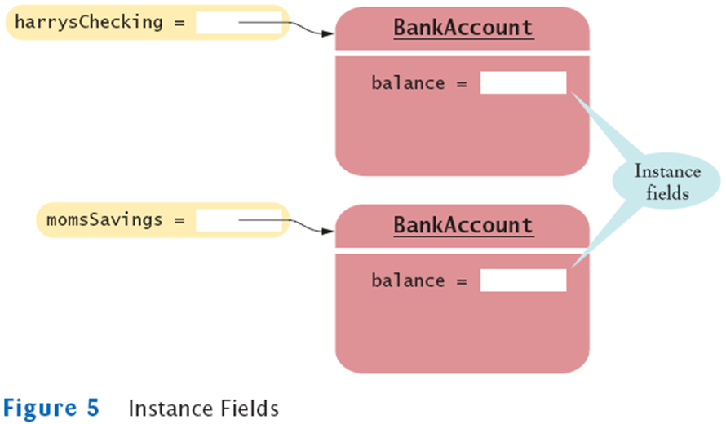
Instance Fields

Slide 19
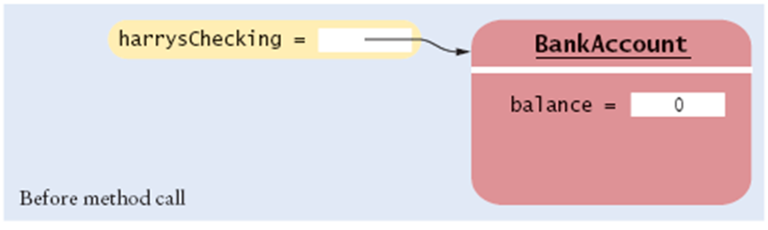
Lifetime of Variables: Calling Method deposit
harrysChecking.deposit(500);

Slide 20
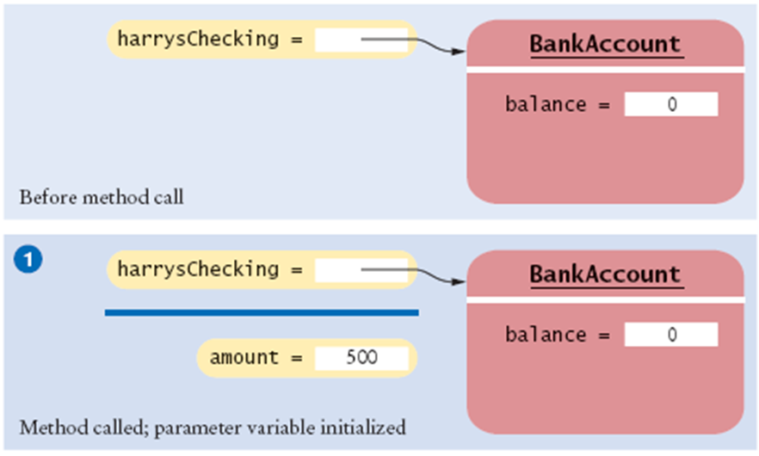
Lifetime of Variables: Calling Method deposit
harrysChecking.deposit(500);

Slide 21
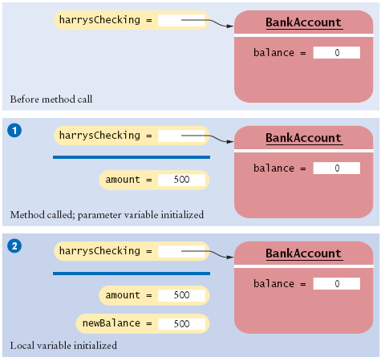
Lifetime of Variables: Calling Method deposit
harrysChecking.deposit(500);
double newBalance = balance + amount;

Slide 22
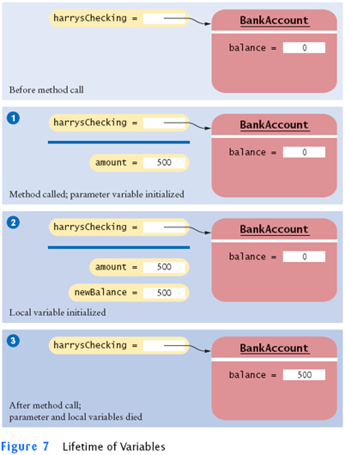
Lifetime of Variables: Calling Method deposit
harrysChecking.deposit(500);
double newBalance = balance + amount;
balance = newBalance;

Slide 23
Constructor
A constructor is a special kind of method invoked during object creation
Its name must match the class name and it has no return type
Called with the new command, not with the dot operator e.g., b = new BankAccount()

Slide 24
Constructor
Multiple constructors may be defined in a single class as long as they have different signatures
Constructors may have parameters used during initialization

Slide 25
Constructor Examples
public class BankAccount
{
public double balance;
public BankAccount()
{
balance = 0;
}
public BankAccount( double initialBalance )
{
balance = initialBalance;
}
...
}

Slide 26
Some Tips on Implementing a Java Class
First, decide on the methods' names and signatures for the class
The public interface of the class
Have empty methods bodies first
Then, determine the instance fields, you need to implement these methods
Next, implement the methods
Specify the statements within the methods; the statements will (most likely) access the instance fields

Slide 27
Some Tips on Implementing a Java Class
Finally, test the class
Write a tester program that creates objects and invokes the methods
In BlueJ, this may be done interactively

Slide 28
Comments
The programs you write will likely be read by someone else
by your instructor or grader
by other members of a programming team
Placing comments in your Java classes improves readability and increases professionalism in your code

Slide 29
Comments
Comment Syntax:
Line comments: // comment
Block comments: /* comment */
Note that comments are ignored by the Java compiler
However, javadoc treats special comment conventions differently

Slide 30
Comment Conventions and javadoc
The most useful comments are
class header comments: describes the class
method header comments: describes method uses and other details
instance fields: describes the role or use of an instance field

Slide 31
Comment Conventions and javadoc
There are existing conventions for writing these comments
Use block comments and begin with /** instead of /*
Have tags (@author, @version, @param, @return) in header comments
The javadoc program automatically produces a class documentation page (html) from these comments
In BlueJ, Tools → Project Documentation (Ctrl+J)

Slide 32
Order of Declarations
Declaration of methods, constructors, and instance fields in a class may come in any order
Most common order
instance fields
constructors
methods
We will use this convention in the programs we demonstrate and create in this course

Slide 33
Testing a Java Class
In a separate Java application (main method)
Create object(s) of the class BankAccount john = new BankAccount();
Invoke methods on the object john.deposit( 1224.50 );
Print values returned by accessor methods to verify the object's state System.out.println( john.getBalance() );

Slide 34
Statements
The body of a method contains a sequence of statements
Statements we have used so far
Assignments: (some come with declarations) balance = 0; double newBalance = balance + amount; BankAccount b = new BankAccount();
Return statements: return balance; // found inside an accessor method
Method calls: b.withdraw( 100.00 );
Output statements: System.out.println( "Hello" ); // this is also a method call
In general, statements end with a semi-colon

Slide 35
Summary
A Java class defines instance fields, methods, and constructors
Instance fields represent an object's state
Methods comprise the public interface of the class to be used by another program
Each method defines a sequence of statements that may affect the object's state/instance fields
Methods may include local variables and parameters
Constructors are special methods that initialize the instance fields of an object

